Slide 1

Diffusion Model
Denoising Diffusion Probabilistic Models
What is the diffusion model?
How to visually understand the diffusion model?
Diffusion models and depth estimation.
Haruko386
Notes:
(；′⌒`)~又想开学又不想开学

Slide 2
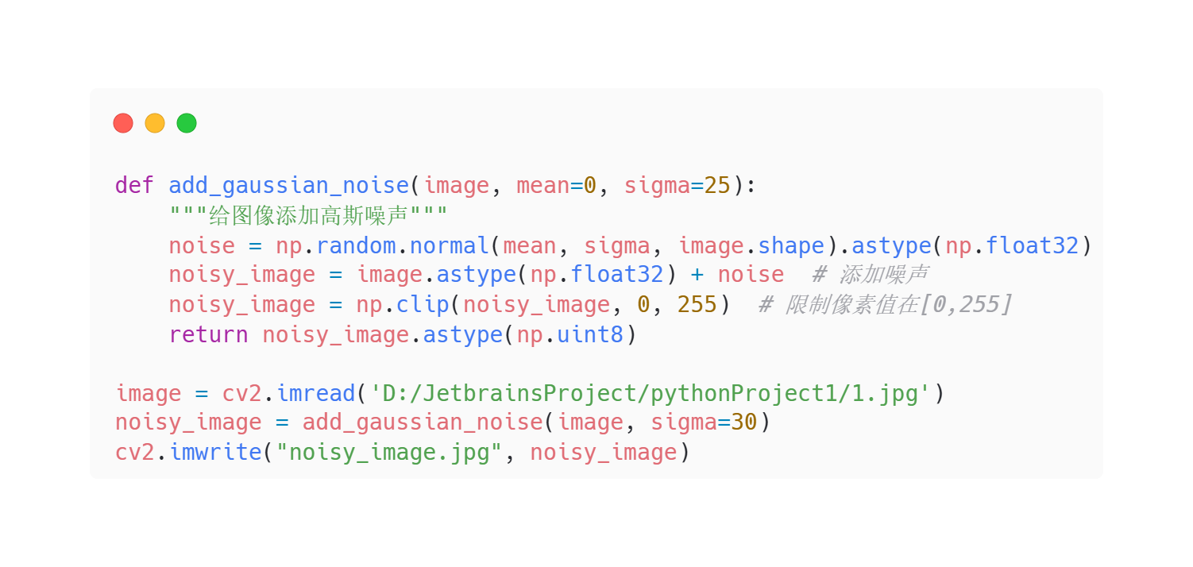
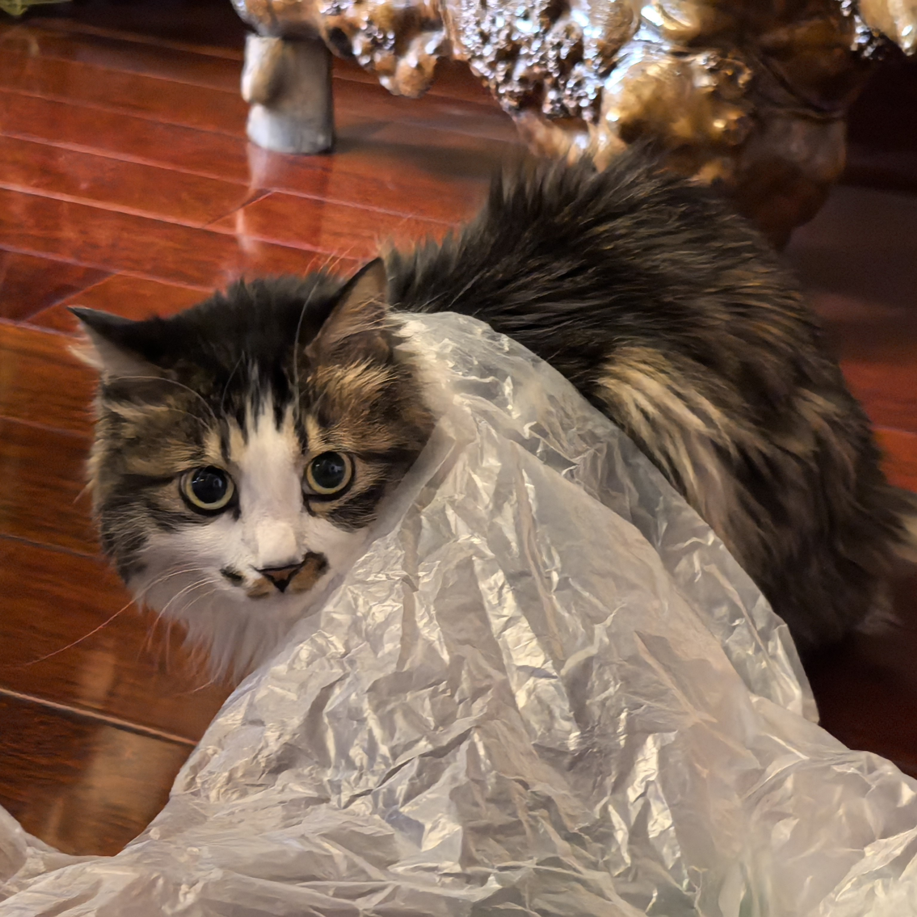
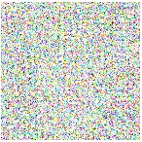
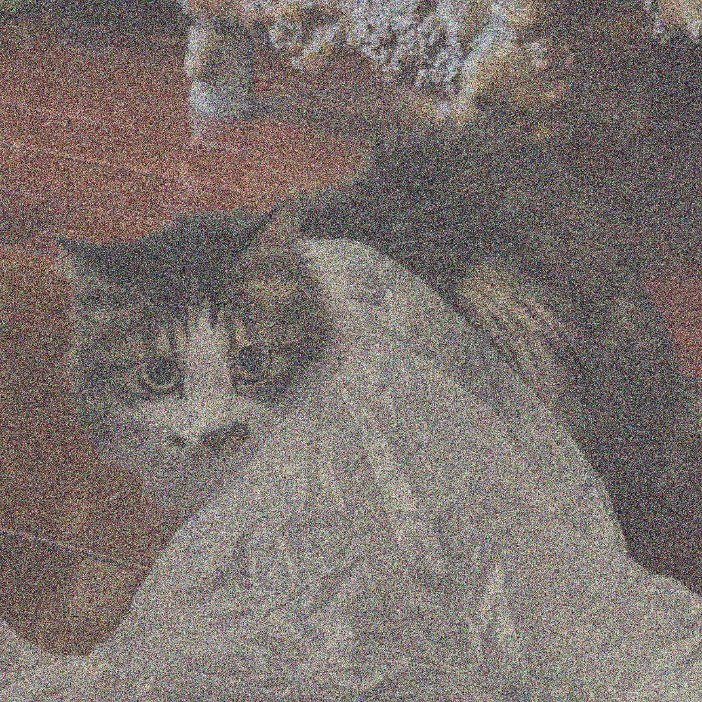

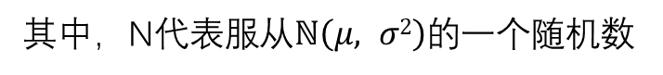
What is Gaussian Noise?
+
[R₀, G₀, B₀], [R₀, G₀, B₀] , [R₀, G₀, B₀], [R₀, G₀, B₀] [R₀, G₀, B₀], [R₀, G₀, B₀] , [R₀, G₀, B₀], [R₀, G₀, B₀] [R₀, G₀, B₀], [R₀, G₀, B₀] , [R₀, G₀, B₀], [R₀, G₀, B₀] [R₀, G₀, B₀], [R₀, G₀, B₀] , [R₀, G₀, B₀], [R₀, G₀, B₀] [R₀, G₀, B₀], [R₀, G₀, B₀] , [R₀, G₀, B₀], [R₀, G₀, B₀] [R₀, G₀, B₀], [R₀, G₀, B₀] , [R₀, G₀, B₀], [R₀, G₀, B₀]
[R₁, G₁, B₁], [R₁, G₁, B₁] , [R₁, G₁, B₁], [R₁, G₁, B₁]
[R₁, G₁, B₁], [R₁, G₁, B₁] , [R₁, G₁, B₁], [R₁, G₁, B₁]
[R₁, G₁, B₁], [R₁, G₁, B₁] , [R₁, G₁, B₁], [R₁, G₁, B₁]
[R₁, G₁, B₁], [R₁, G₁, B₁] , [R₁, G₁, B₁], [R₁, G₁, B₁]
[R₁, G₁, B₁], [R₁, G₁, B₁] , [R₁, G₁, B₁], [R₁, G₁, B₁]
[R₁, G₁, B₁], [R₁, G₁, B₁] , [R₁, G₁, B₁], [R₁, G₁, B₁]
+
[R₀+N, G₀+N, B₀+N]
其中，N代表服从$ℕ\left(μ, σ2\right)$的一个随机数

Slide 3
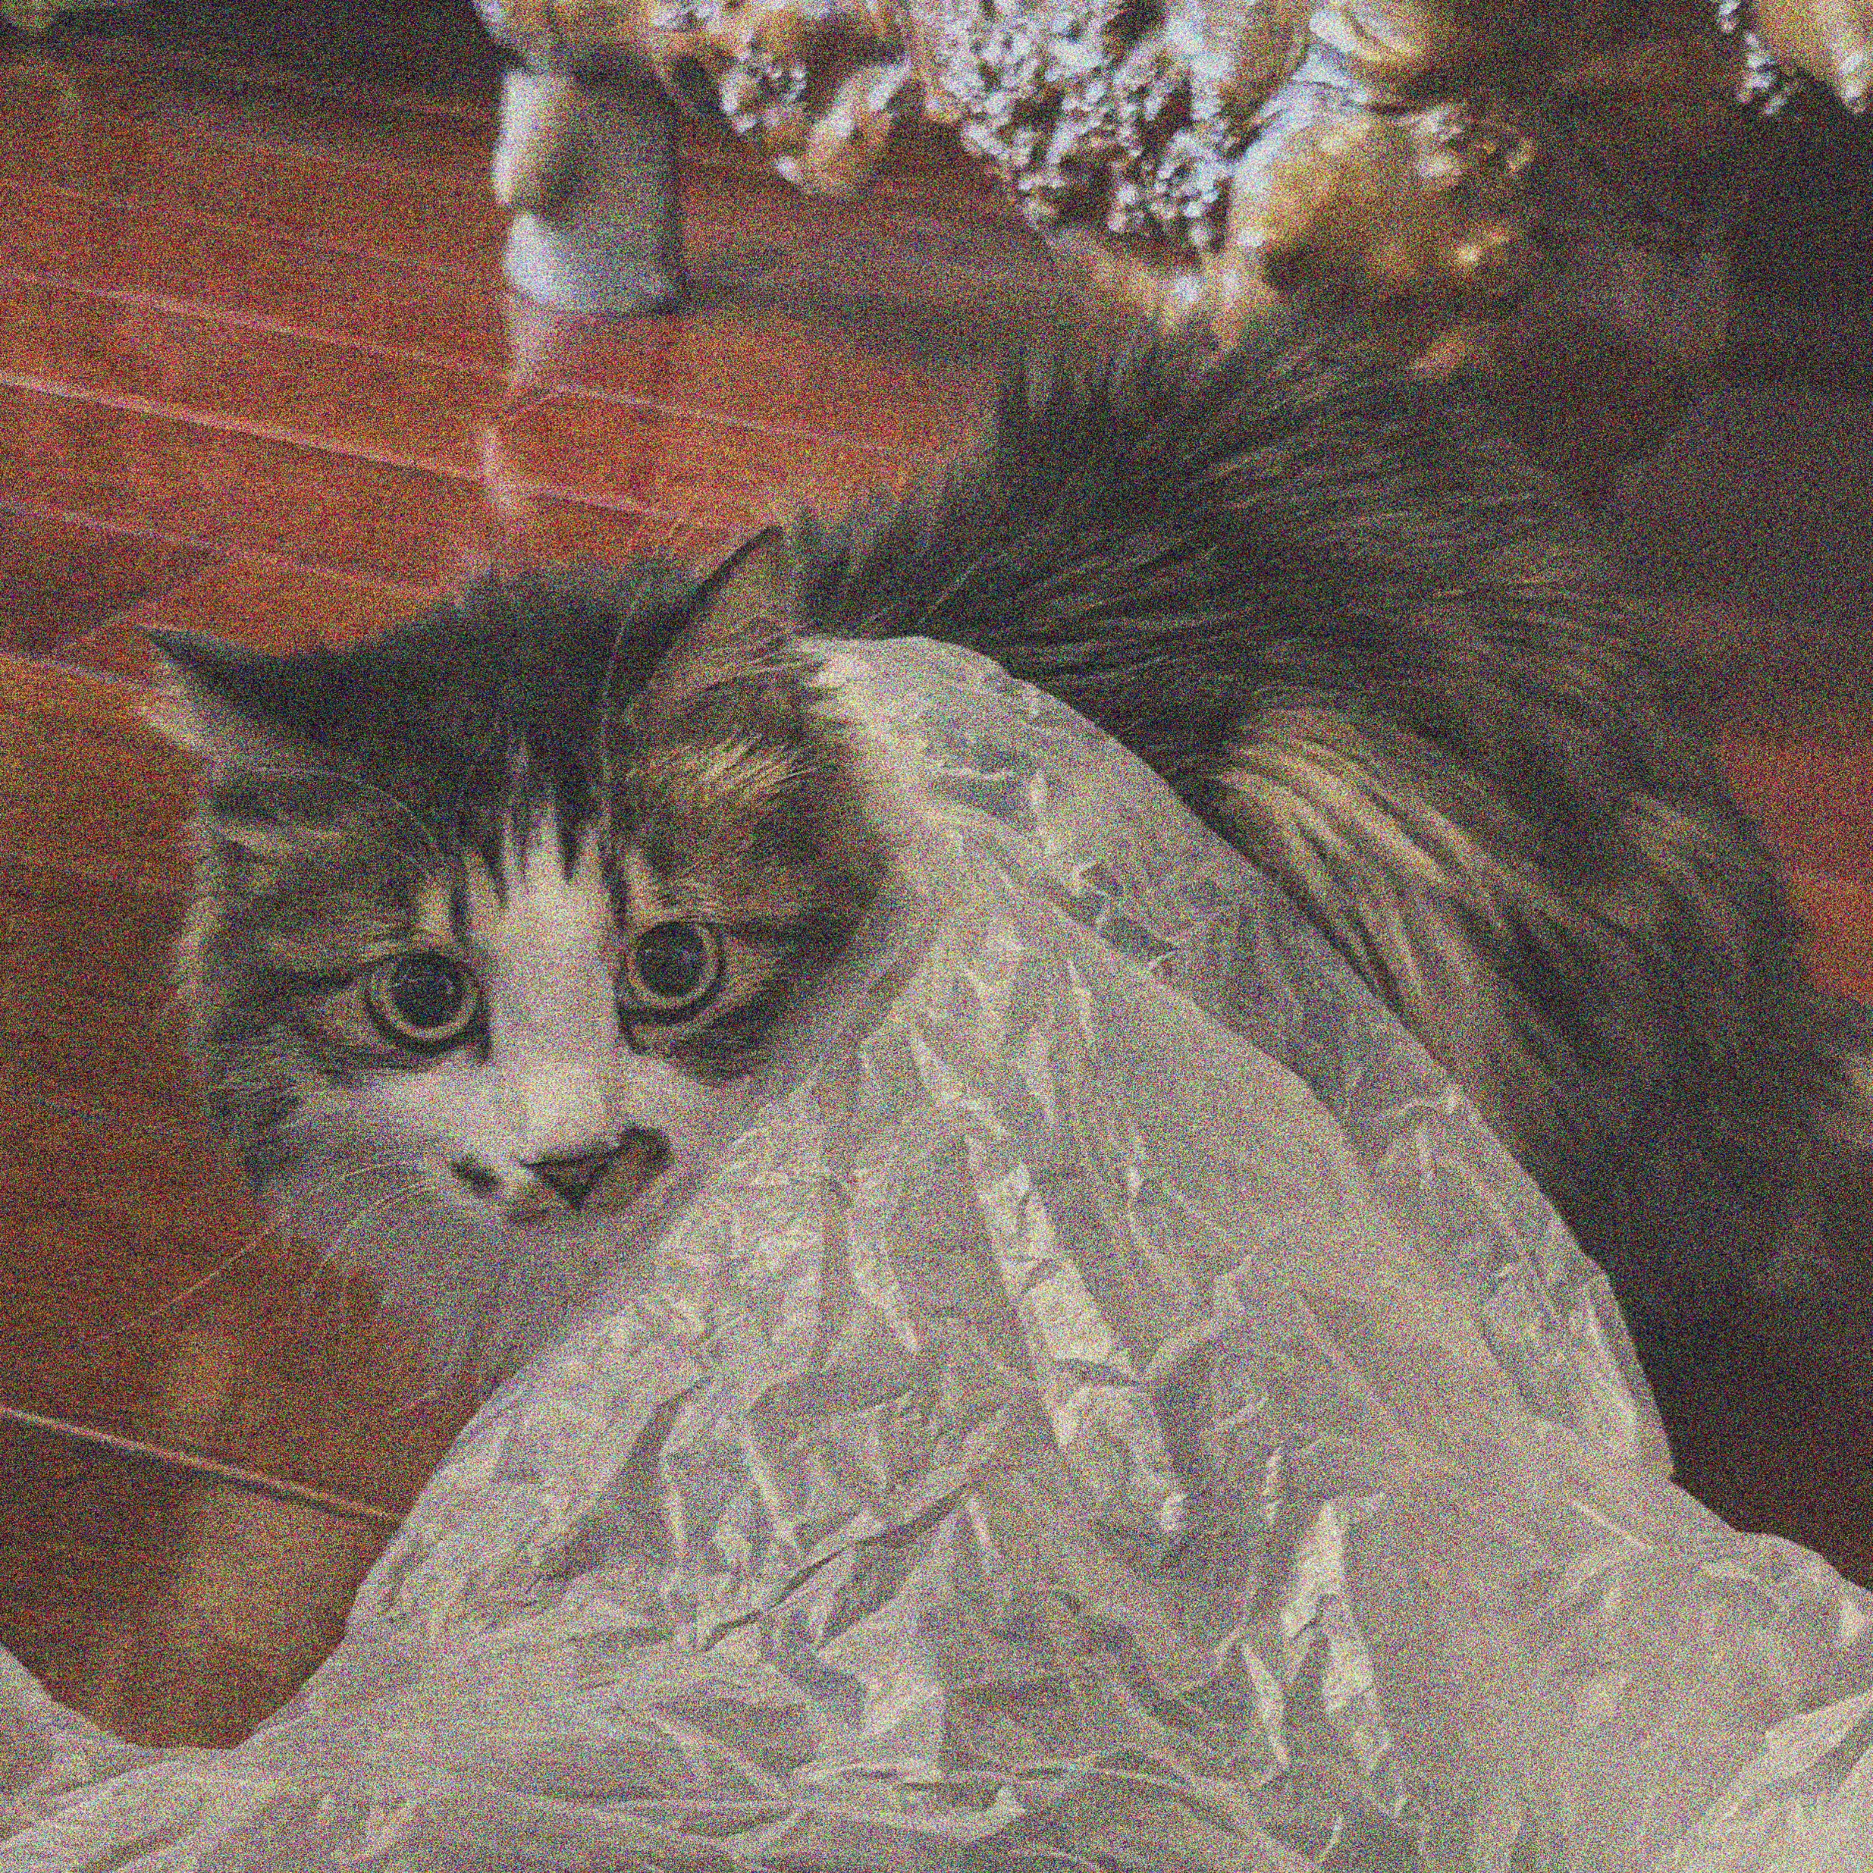
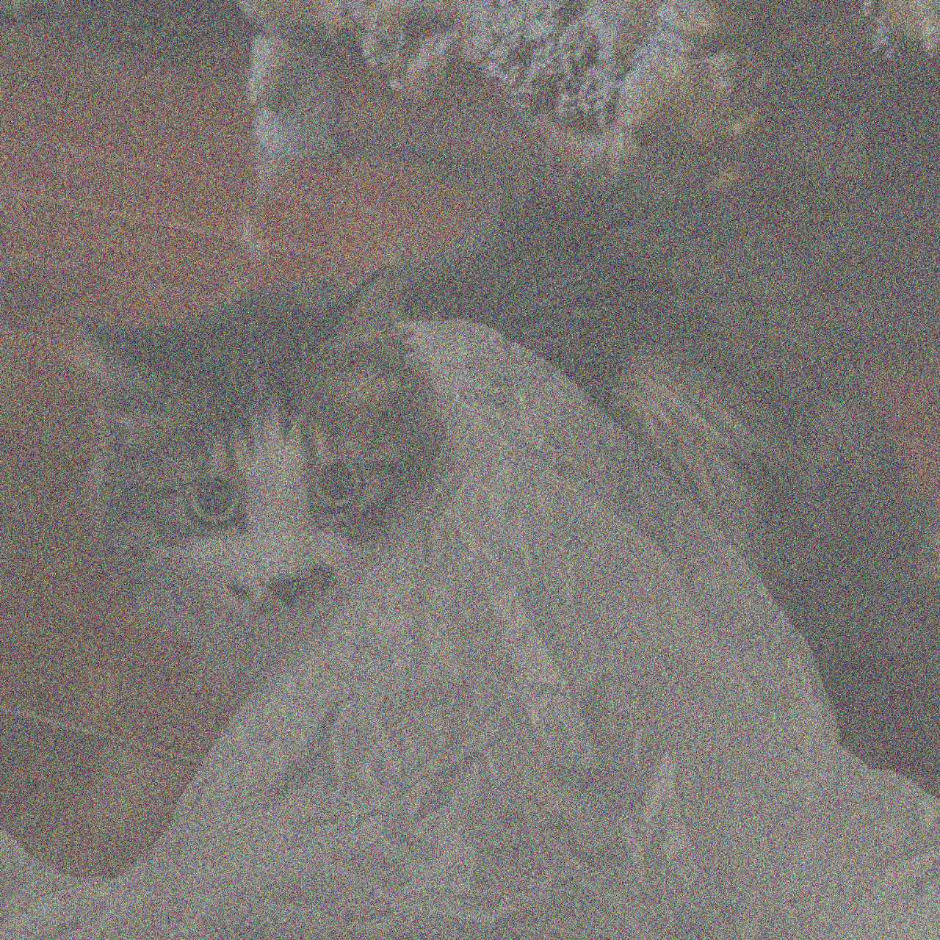

What is Diffusion Model ?
Denoising Diffusion Probabilistic Models ^{[1]}
^{[2]}
Forward Diffusion Process
Data
Noise
Reverse Diffusion Process
Data
Noise
[1] Ho J, Jain A, Abbeel P. Denoising diffusion probabilistic models. NeuraIPS, 2020.
[2] Small MI. Jingxuan Wang, 2020

Slide 4


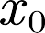
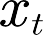

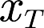




What is Diffusion Model ?
Data
+
Noise
+
+
Data
Noise
-
Model
(𝑡)
Denoise Process

Slide 5


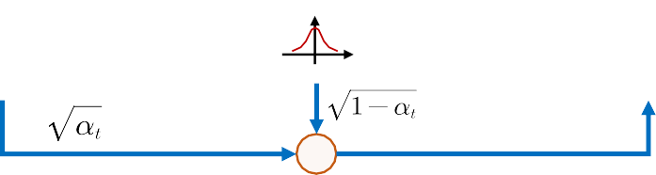
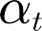

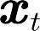
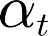
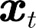
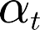

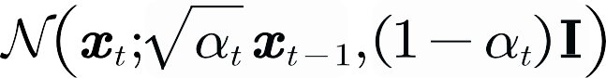


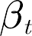
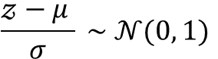
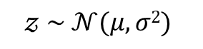
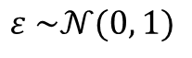
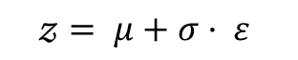
Forward Diffusion Process
Data
Noise
+
Gauss distribution
+
+
$$𝓏 \sim 𝒩(μ, σ2)$$
$$\frac{𝓏−μ }{σ} \sim 𝒩(0, 1)$$
gaussian
signal
noise
$$𝓏= μ+σ· ε$$
$$ε \sim 𝒩(0, 1)$$
mean
variance

Slide 6
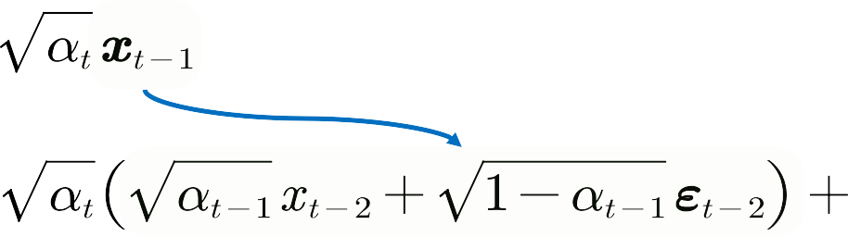





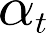
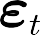
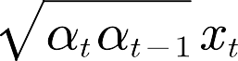
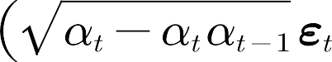


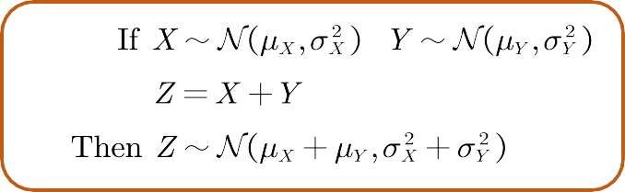

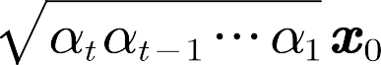
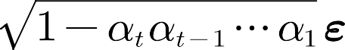






Forward Diffusion Process
① forward (close-form)
Noise
Noise

Slide 7


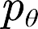





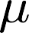







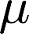



Reverse Diffusion Process
Markov
Data
Noise
+
+
impossible!
Neural Network
Assume: the output is gaussian
Target Distribution
Approximated Distribution

Slide 8
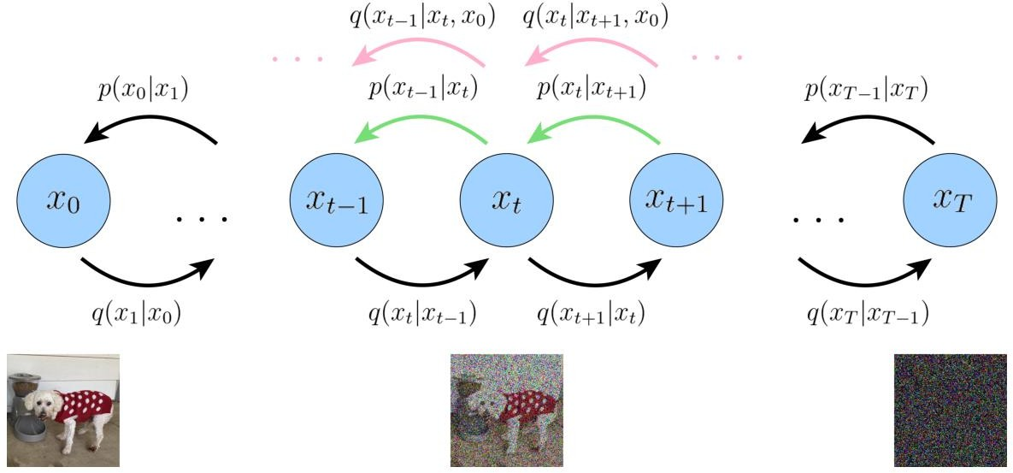
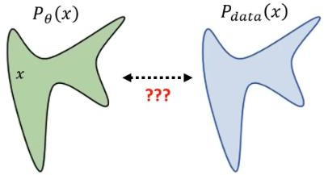
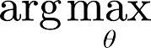
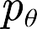
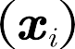

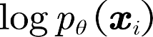
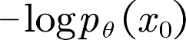

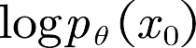

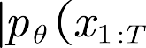
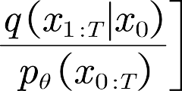


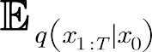

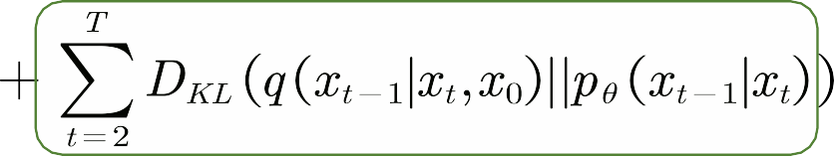




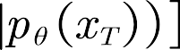
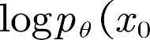
Maximum Likelihood Estimation
② optimization (view 1)
min
min
ELBO
min

Slide 9
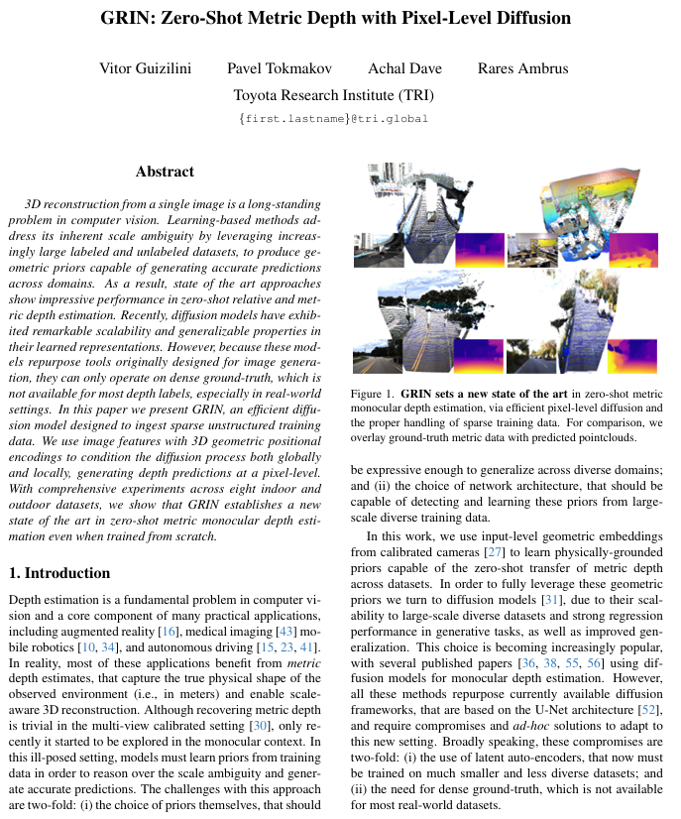
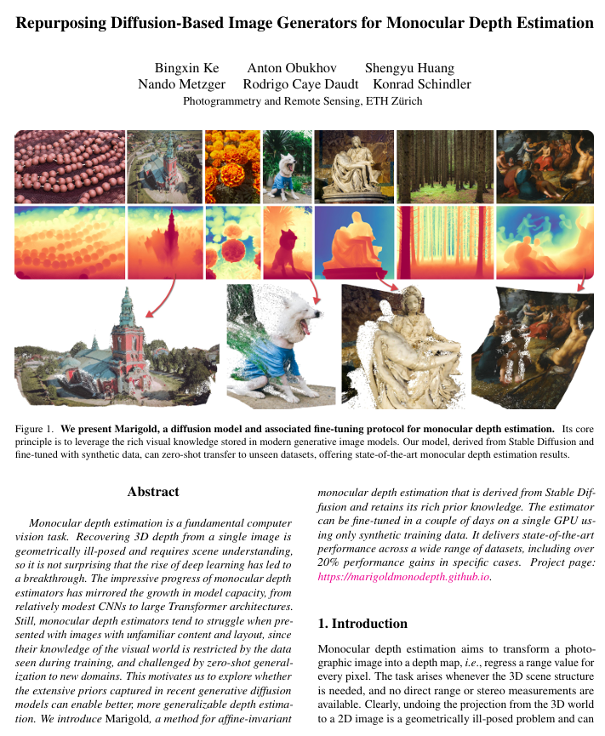
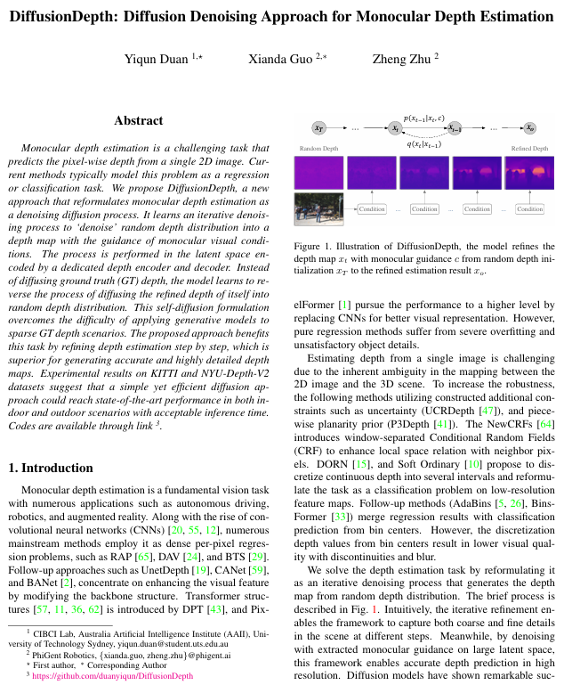
Application in Depth Estimation
CVPR 2024
Vitor Guizilini*
CVPR 2024
Bingxin Ke
CVPR 2024
Yiqun Duan

Slide 10

Thanks for Watching
Email: Haruko386@outlook.com
Date: 2025/2/23

